Slide 1
A FLEXIBLE EMAIL CLIENT APP

Slide 2
DESCRIPTION
A flexible email client app can mean a number of things depending on the context, but generally, it refers to an email application that offers adaptability, customization, and an intuitive user experience. Here's a breakdown of features that would make an email client flexible.

Slide 3
Tools & Libraries
smtplib: For sending emails via SMTP.
imaplib: For receiving emails via IMAP.
email: For parsing email messages and attachments.
Tkinter: For the GUI.
OAuth2 libraries: For secure email provider authentication.

Slide 4
MAIN ACTIVITY.KT
package com.example.emailclient
import android.content.Intent
import android.os.Bundle
import android.widget.*
import androidx.appcompat.app.AppCompatActivity
import androidx.recyclerview.widget.LinearLayoutManager
import androidx.recyclerview.widget.RecyclerView
import com.example.emailclient.network.RetrofitClient
import com.example.emailclient.network.EmailApi
import com.example.emailclient.network.Email
import retrofit2.Call
import retrofit2.Callback
import retrofit2.Response
import androidx.swiperefreshlayout.widget.SwipeRefreshLayout

Slide 5
class MainActivity : AppCompatActivity() {
private lateinit var inboxRecyclerView: RecyclerView
private lateinit var composeButton: Button
private lateinit var searchView: SearchView
private lateinit var emptyInboxText: TextView
private lateinit var swipeRefreshLayout: SwipeRefreshLayout
private lateinit var emailListAdapter: EmailAdapter
private var emailList: MutableList<Email> = mutableListOf()
override fun onCreate(savedInstanceState: Bundle?) {
super.onCreate(savedInstanceState)
setContentView(R.layout.activity_main)

Slide 6
// Initialize UI elements
inboxRecyclerView = findViewById(R.id.inboxRecyclerView)
composeButton = findViewById(R.id.composeButton)
searchView = findViewById(R.id.searchView)
emptyInboxText = findViewById(R.id.emptyInboxText)
swipeRefreshLayout = findViewById(R.id.swipeRefreshLayout)
// Setup RecyclerView for inbox emails
emailListAdapter = EmailAdapter(emailList, object : EmailAdapter.OnEmailClickListener {
override fun onEmailClick(email: Email) {
openEmail(email)
}
})

Slide 7
inboxRecyclerView.layoutManager = LinearLayoutManager(this)
inboxRecyclerView.adapter = emailListAdapter
// Setup Swipe to refresh
swipeRefreshLayout.setOnRefreshListener {
fetchEmails()
}
// Setup Compose button to compose new emails
composeButton.setOnClickListener {
composeNewEmail()
}
// Search functionality
searchView.setOnQueryTextListener(object : SearchView.OnQueryTextListener {
override fun onQueryTextSubmit(query: String?): Boolean {
return false
}

Slide 8
)
// Fetch initial emails
fetchEmails()
}
private fun fetchEmails() {
// Simulate fetching emails from backend (via Retrofit or mock data)
swipeRefreshLayout.isRefreshing = true
RetrofitClient.emailApi.getEmails().enqueue(object : Callback<List<Email>> {
override fun onResponse(call: Call<List<Email>>, response: Response<List<Email>>) {
if (response.isSuccessful) {
emailList.clear()
emailList.addAll(response.body() ?: emptyList())
emailListAdapter.notifyDataSetChanged()
checkInboxEmpty()
}

Slide 9
swipeRefreshLayout.isRefreshing = false
}
override fun onFailure(call: Call<List<Email>>, t: Throwable) {
swipeRefreshLayout.isRefreshing = false
Toast.makeText(this@MainActivity, "Failed to fetch emails", Toast.LENGTH_SHORT).show()
}
})
}
private fun checkInboxEmpty() {
if (emailList.isEmpty()) {
emptyInboxText.visibility = TextView.V

Slide 10
} else {
emptyInboxText.visibility = TextView.GONE
}
}
private fun openEmail(email: Email) {
val intent = Intent(this, ReadEmailActivity::class.java)
intent.putExtra("email_subject", email.subject)
intent.putExtra("email_sender", email.sender)
intent.putExtra("email_body", email.body)
intent.putExtra("email_date", email.date)
startActivity(intent)
}
private fun composeNewEmail() {
val intent = Intent(this, ComposeEmailActivity::class.java)
startActivity(intent)
}
private fun filterEmails(query: String?) {
val filteredEmails = emailList.filter { email ->
email.subject.contains(query ?: "", ignoreCase = true) ||
c

Slide 11
email.sender.contains(query ?: "", ignoreCase = true)
}
emailListAdapter.updateList(filteredEmails)
}
// Simulating the data model for email
data class Email(
val sender: String,
val subject: String,
val body: String,
val date: String
)
// Adapter for email list
class EmailAdapter(private var emails: List<Email>, private val listener: OnEmailClickListener) :
RecyclerView.Adapter<EmailAdapter.EmailViewHolder>() {

Slide 12
interface OnEmailClickListener {
fun onEmailClick(email: Email)
}
inner class EmailViewHolder(itemView: android.view.View) : RecyclerView.ViewHolder(itemView) {
val senderTextView: TextView = itemView.findViewById(R.id.senderTextView)
val subjectTextView: TextView = itemView.findViewById(R.id.subjectTextView)
val dateTextView: TextView = itemView.findViewById(R.id.dateTextView)
init {
itemView.setOnClickListener {
listener.onEmailClick(emails[adapterPosition])
}
}
}

Slide 13
override fun onCreateViewHolder(parent: android.view.ViewGroup, viewType: Int): EmailViewHolder {
val itemView = android.view.LayoutInflater.from(parent.context)
.inflate(R.layout.item_email, parent, false)
return EmailViewHolder(itemView)
}
override fun onBindViewHolder(holder: EmailViewHolder, position: Int) {
val email = emails[position]
holder.senderTextView.text = email.sender
holder.subjectTextView.text = email.subject
holder.dateTextView.text = email.date
}
override fun getItemCount(): Int = emails.size
fun updateList(updatedEmails: List<Email>) {
this.emails = updatedEmails
notifyDataSetChanged()
}
}
}

Slide 14
<?xml version="1.0" encoding="utf-8"?>
<androidx.constraintlayout.widget.ConstraintLayout xmlns:android="http://schemas.android.com/apk/res/android"
xmlns:app="http://schemas.android.com/apk/res-auto"
xmlns:tools="http://schemas.android.com/tools"
android:layout_width="match_parent"
android:layout_height="match_parent"
tools:context=".MainActivity">
<!-- SwipeRefreshLayout to pull to refresh the inbox -->
<androidx.swiperefreshlayout.widget.SwipeRefreshLayout
android:id="@+id/swipeRefreshLayout"
android:layout_width="match_parent"
android:layout_height="match_parent"
app:layout_constraintTop_toTopOf="parent"
app:layout_constraintStart_toStartOf="parent"
app:layout_constraintEnd_toEndOf="parent">

Slide 15
<!-- RecyclerView to display the list of emails -->
<androidx.recyclerview.widget.RecyclerView
android:id="@+id/inboxRecyclerView"
android:layout_width="match_parent"
android:layout_height="0dp"
android:layout_marginTop="16dp"
app:layout_constraintTop_toTopOf="parent"
app:layout_constraintStart_toStartOf="parent"
app:layout_constraintEnd_toEndOf="parent"
app:layout_constraintBottom_toTopOf="@id/composeButton" />
</androidx.swiperefreshlayout.widget.SwipeRefreshLayout>

Slide 16
<!-- Button to compose new email -->
<Button
android:id="@+id/composeButton"
android:layout_width="wrap_content"
android:layout_height="wrap_content"
android:text="Compose Email"
app:layout_constraintTop_toBottomOf="@id/inboxRecyclerView"
app:layout_constraintStart_toStartOf="parent"
app:layout_constraintEnd_toEndOf="parent"
android:layout_marginTop="16dp" />
<!-- Search bar for filtering emails -->
<androidx.appcompat.widget.SearchView
android:id="@+id/searchView"
android:layout_width="0dp"
android:layout_height="wrap_content"
android:queryHint="Search emails..."
app:layout_constraintTop_toTopOf="parent"
app:layout_constraintStart_toStartOf="parent"
app:layout_constraintEnd_toEndOf="parent"
android:layout_marginTop="16dp" />

Slide 17
<!-- Search bar for filtering emails -->
<androidx.appcompat.widget.SearchView
android:id="@+id/searchView"
android:layout_width="0dp"
android:layout_height="wrap_content"
android:queryHint="Search emails..."
app:layout_constraintTop_toTopOf="parent"
app:layout_constraintStart_toStartOf="parent"
app:layout_constraintEnd_toEndOf="parent"
android:layout_marginTop="16dp" />

Slide 18
<!-- Text to display when inbox is empty -->
<TextView
android:id="@+id/emptyInboxText"
android:layout_width="wrap_content"
android:layout_height="wrap_content"
android:text="No emails available"
android:textSize="18sp"
android:visibility="gone"
app:layout_constraintTop_toTopOf="parent"
app:layout_constraintStart_toStartOf="parent"
app:layout_constraintEnd_toEndOf="parent"

Slide 19
<
app:layout_constraintBottom_toTopOf="@id/composeButton"
android:layout_marginTop="32dp" />
</androidx.constraintlayout.widget.ConstraintLayout>

Slide 20
This xml defines a Simple email inbox layoutwith the following element:
1. SwipeRefreshLayout for pull-to-refresh functionality.
2. RecyclerView to display a list of emails.
3. Button to compose a new email, positioned below the RecyclerView.
4. SearchView for filtering emails, placed at the top.
5. TextView to display "No emails available" when the inbox is empty, positioned above the compose button.

Slide 21
Flexibility Considerations:
T o make the email client truly flexible and adaptable for future improvements, consider the following strategies:
Network Integration:
Attachments Support:

Slide 22
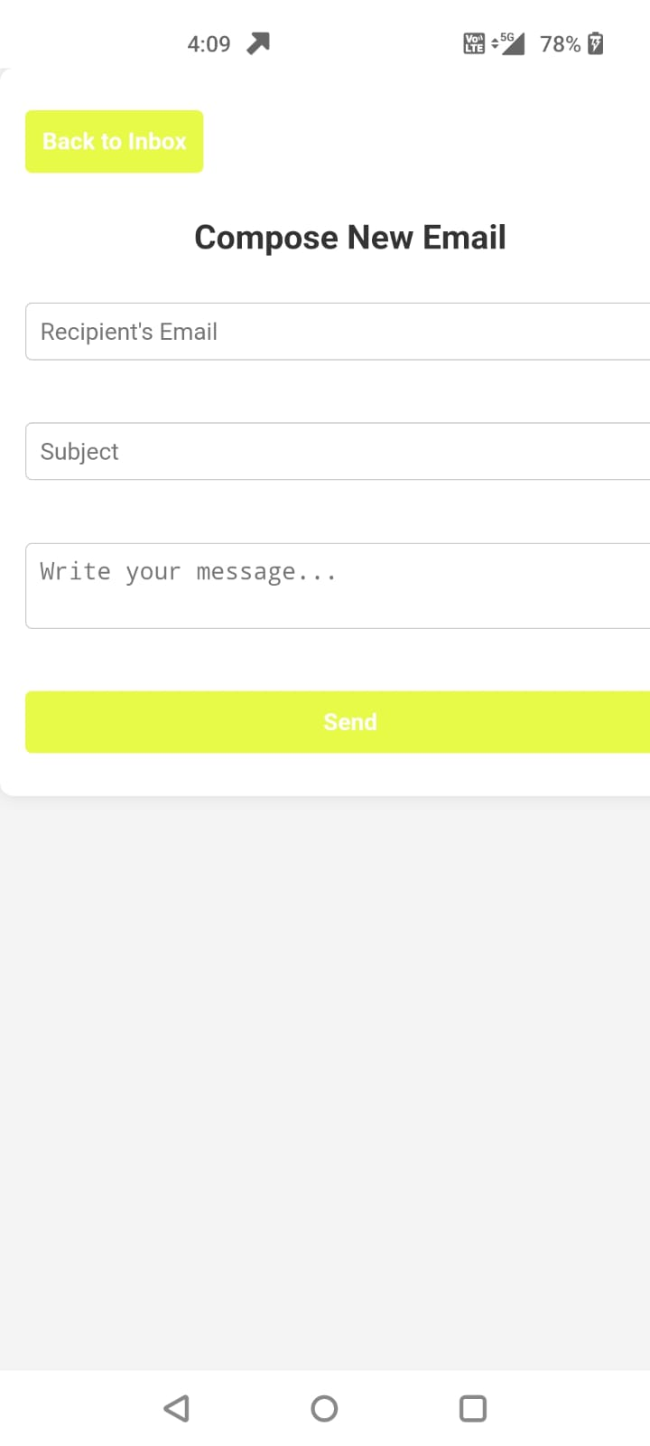
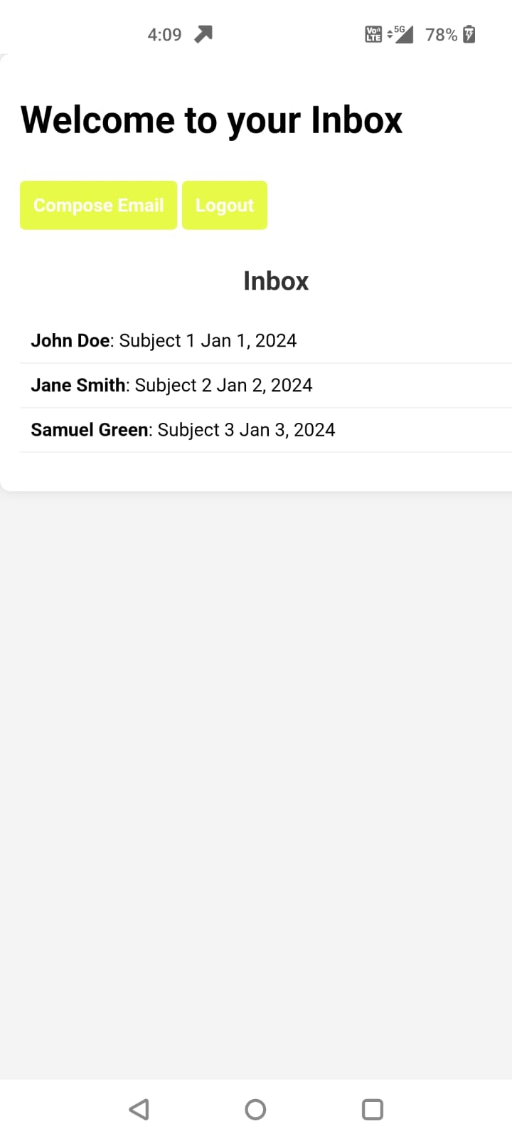
OUTPUT:

Slide 23
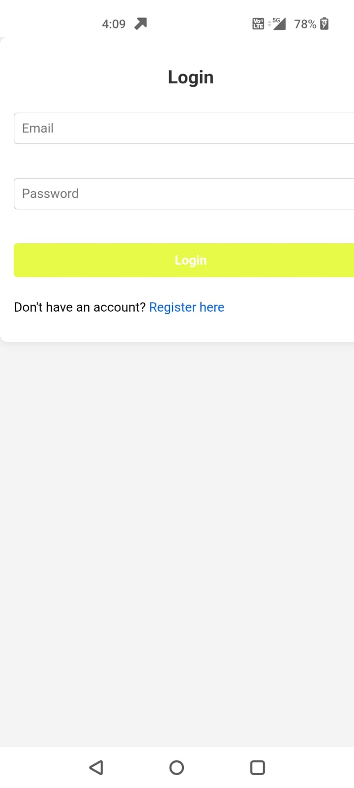

Slide 24
conclusion
Building a flexible and robust email client app requires attention to detail in terms of UX, data handling, and scalability. By implementing the features above, such as email display, search, compose functionality, and refresh, you can provide users with a responsive and functional email experience.

